Slide 1

SWFL Retail Fuel Pricing Analysis
NASDAQ: COST
March 12, 2023

Slide 2
Agenda
I
Introduction
II
Methodology
III
Short-Term Forecast
IV
Long-Term Stress Testing
V
Risk Management

Slide 3
Introduction

Slide 4
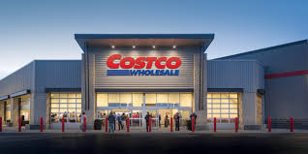

Introduction
Context
Problem
SWFL is a "captive market" for fuel & sensitive to Gulf Coast supply chain shocks.
Standard pricing models are purely reactive; they miss the "Fear Premium" of global conflict.
Objective
Mathematically bridge the gap between Middle Eastern escalations and the SWFL Costco pump price.

Slide 5
Methodology

Slide 6


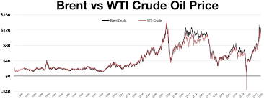
Methodology
Strategy
Key Inputs
Create a hybrid Machine Learning & Stochastic pipeline.
Oil Equities: 60-day trailing energy complex trends.
Defense Proxies: Equity returns of Lockheed Martin & RTX (Leading indicators of conflict).
FinBERT NLP: Contextual AI scoring of news headlines (e.g., Strait of Hormuz stalling).
Why?
Non-linear models capture "shocks" that standard averages ignore

Slide 7
Model Results

Slide 8
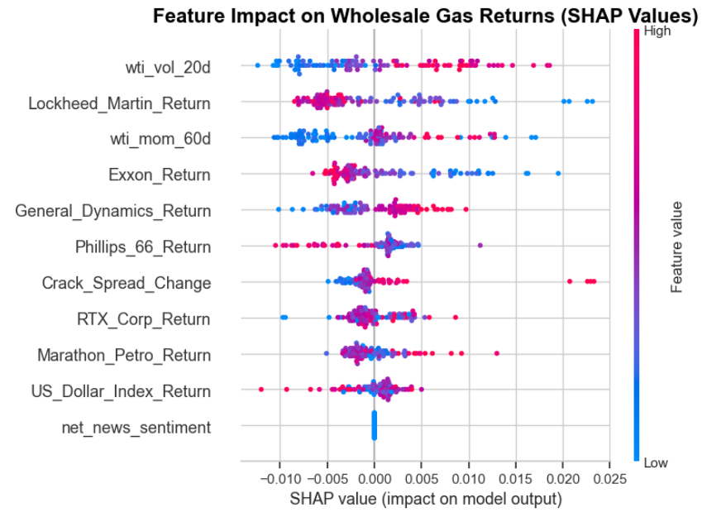
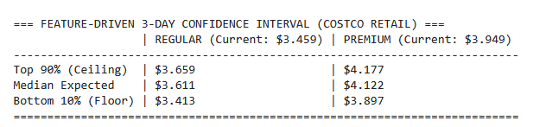
Model Construction & Results
Features
Results
WTI momentum and Defense sector gains are currently the dominant price drivers.

Slide 9
Simulation Results

Slide 10
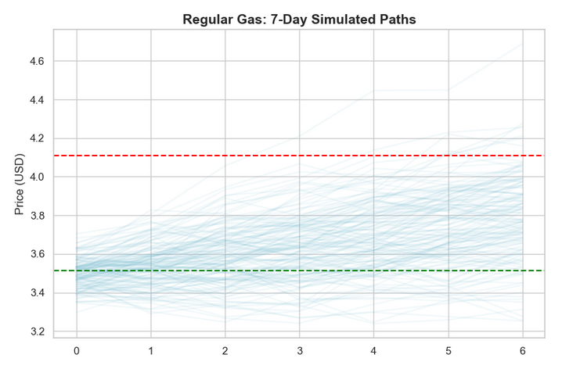
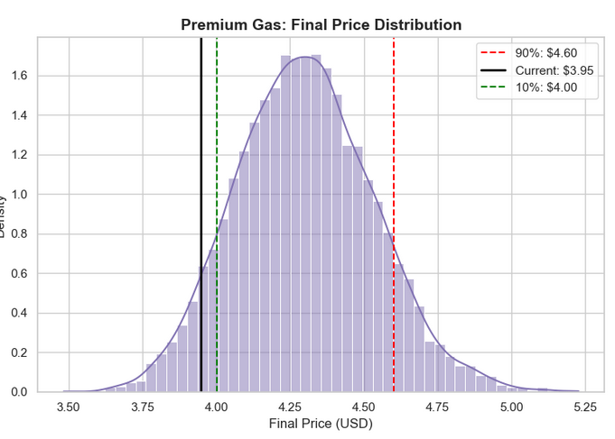
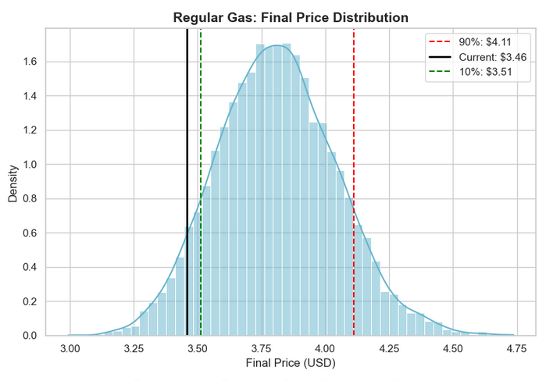
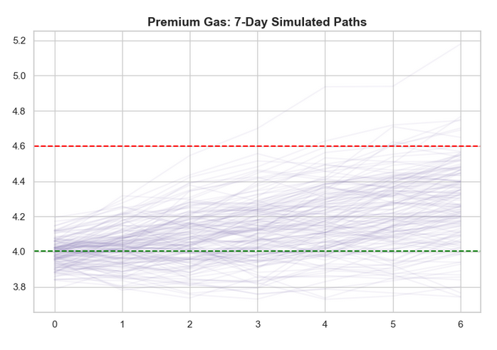
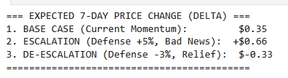
Simulation Results
Regular
Premium

Slide 11
Strategic Risk Context

Slide 12
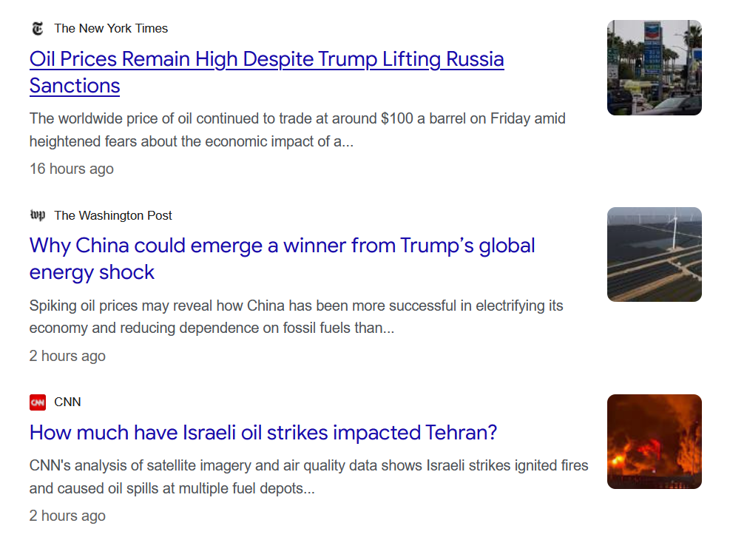
Strategic Risk Context
Takeaway
Multiple scenarios should be tracked
Refilling is the safer option
Evaluation
Pros:
Asymmetric Risk Clarity
Predictive Lead Time
Cons:
System Fragility
Exogenous Blindness
Notes:
Pros:
Asymmetric Risk Clarity: Quantifies the massive $0.66 upside risk versus the minor $0.04 downside, framing immediate procurement as a low-cost, high-value "insurance policy."
Predictive Lead Time: Integrates alternative signals (FinBERT news sentiment and Defense proxies) to identify price hikes before they manifest at retail terminals.
Cons:
System Fragility: The model's accuracy is strictly dependent on the continuous uptime and site structure of third-party web-scraping targets and APIs.
Exogenous Blindness: Mathematical models cannot anticipate unannounced "Black Swan" events, such as emergency strategic oil releases or unilateral government policy shifts.

